Slide 1
CGB1201 – JAVA PROGRAMMING PROJECT REVIEW-2
Department of Computer Science and Engineering
Academic Year : 2024 – 2025 (Odd Semester)
Register Number : 927623BCS011
Name : M S ARUN SANJEEV
Year : IInd Year
Semester : IIIrd Semester
Section : CSE - A
Date : 26-11-2024

Slide 2

Title of the Project
COLLEGE MANAGEMENT SYSTEM (CMS)

Slide 3
Abstract
This project presents a comprehensive College Management System (CMS) implemented to integrate and automate various academic and administrative tasks within a college. The system is designed to efficiently manage student information, faculty details, courses, attendance, grades, and other essential functions, streamlining operations across departments. By providing secure access to both students and faculty, the CMS enables the seamless handling of critical data, such as student enrollment, course registration, grading, and attendance tracking. A key feature of the system is its ability to generate reports, allowing for real-time monitoring of academic progress and administrative activities. The CMS is developed with user-friendly interfaces and robust data validation to ensure secure, accurate, and reliable management of academic information, ultimately improving the overall efficiency and effectiveness of college operations

Slide 4
Abstract with CO/PO Mapping
Abstract | CO | POs | PSO
The College Management System (CMS) streamlines academic and administrative tasks by integrating student information, faculty details, courses, attendance, and grading into a centralized platform. It provides secure access for both students and faculty, enabling efficient handling of enrollment, course registration, grading, and attendance tracking. Key features include real-time report generation for monitoring academic progress and administrative activities. With user-friendly interfaces and robust data validation, the CMS ensures secure, accurate, and reliable management of academic information, enhancing the overall efficiency of college operations. | CO-1 CO-2 CO-3 CO-4 | PO-1 PO-2 PO-3 PO-4 PO-5 PO-6 PO-7 PO-8 PO-9 PO-10 PO-11 PO-12 | PSO-1 PSO-2

Slide 5
Introduction
The College Management System (CMS) is designed to automate and streamline various academic and administrative processes within a college.
It consolidates key tasks such as managing student information, faculty data, courses, and attendance, providing a unified platform for efficient operations.
With secure access for students and faculty, the CMS enhances the management of enrollment, course registration, grading, and attendance tracking. Its real-time reporting feature and user-friendly interface improve decision-making and ensure the accurate handling of academic data, contributing to a more organized and effective college environment.

Slide 6
Java Programming - Concepts Used
Swing Framework: Used to design the Graphical User Interface (GUI), providing an intuitive and interactive experience for end users.
JDBC (Java Database Connectivity): Establishes a connection with the MySQL database, allowing efficient data manipulation and retrieval.
Exception Handling: Ensures the program handles runtime errors gracefully, maintaining system stability.
Multi-threading: Implemented in modules like the chat server to handle multiple concurrent user sessions efficiently.

Slide 7
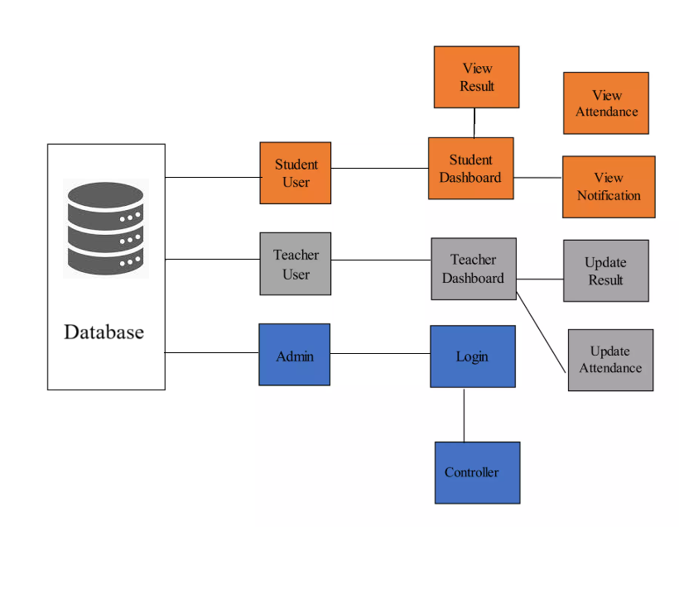
Proposed Architecture

Slide 8
Proposed Architecture - Description
The system architecture begins with the Teacher entity, which represents educators in the college. Each teacher is identified by a Teacher ID and associated attributes such as Name.
Teachers are linked to Subjects they teach, creating a relationship that ensures proper course allocation and tracking. This structure allows seamless management of faculty data, including their assigned courses and responsibilities.
The Subject entity defines the courses taught within the system. Each subject is uniquely identified by a Subject Code (S.Code) and Subject Name (S.Name).
Subjects are connected to teachers through the "Teaches" relationship, ensuring a clear mapping between instructors and their respective courses. Additionally, this module simplifies curriculum management and supports the organization of academic schedules.

Slide 9
Proposed Architecture - Description (Cont..)
The Student entity serves as the core of the system, representing all enrolled students. Each student is characterized by attributes such as Student ID, Name, Semester, and Course.
This module organizes student information and ensures accurate tracking across multiple semesters and courses.
The Attendance entity is closely linked to students, subjects, and their respective teachers. It captures data such as Month, Student ID, Subject, Status, and Semester.
The relationship "Belongs" connects attendance records to specific students and subjects, providing comprehensive insights into academic participation.
This module enhances monitoring and evaluation processes, enabling efficient attendance management for the institution.

Slide 10
List of Modules
Login Module
Student Management Module
Faculty Management Module
Course Management Module
Attendance Module
Chat Forum Module
Result Module

Slide 11
Module Description
1.Login Module
The login module is the entry point to the system, responsible for verifying user credentials and determining their access levels. It categorizes users into three roles: Admin, Faculty, and Student, providing role-specific dashboards and permissions.
Admin Login: Allows full access to manage the system, including creating courses, assigning faculty, managing student data, and generating reports.
Faculty Login: Provides tools to manage attendance, upload marks, and communicate with students.
Student Login: Grants access to personal data, course details, attendance records, and results.

Slide 12
Module Description
2.Student Management Module
This module maintains a comprehensive database of student details and ensures seamless integration with other modules.
Enrollment Management: Automates student registration and ensures data accuracy by validating inputs like personal details, course sections, and contact information.
Course Allocation: Links students to their respective courses and semesters, maintaining a clear record of academic progress.
Data Management: Allows admins to edit, update, or delete student records when necessary.

Slide 13
Module Description
3.Faculty Management Module
This module streamlines faculty-related operations, ensuring efficient handling of responsibilities and records.
Faculty Profiles: Maintains detailed information about faculty, including their qualifications, contact details, and assigned courses.
Course Management: Enables the admin to assign or reassign courses and subjects to faculty members dynamically.
Attendance Monitoring: Assists faculty in managing student attendance records and ensuring data consistency

Slide 14
Module Description
4.Attendance Module
The attendance module simplifies the process of tracking and analyzing student attendance.
Attendance Recording: Allows faculty to mark attendance for each session and update it in real-time.
Report Generation: Provides detailed attendance reports, highlighting defaulters and overall participation rates.
5 Course and Subject Management Module
This module ensures seamless handling of courses and subjects offered by the institution.
Course Creation: Admins can create or modify courses, defining their structure, duration, and associated subjects.
Subject Assignment: Links subjects to courses and assigns faculty members to handle them.
Course Status Monitoring: Tracks the number of students enrolled in each course and ensures resource allocation aligns with demand.

Slide 15
Module Description
6. Notification and Chat Module
This module enhances communication among students, faculty, and administrators through real-time messaging and notifications.
Real-Time Notifications: Sends alerts for important updates, such as exam schedules, assignment deadlines, and announcements.
Chat Functionality: Facilitates direct messaging between users, ensuring quick resolution of queries and better collaboration.
Admin Announcements: Allows the admin to broadcast messages to all users or specific groups.
7. Marks and Results Module
This module automates the process of entering, storing, and analyzing student performance data.
Grade Entry: Allows faculty to input marks for assignments, exams, and other assessments.
Result Calculation: Automatically computes final grades based on predefined weightage and generates comprehensive result reports.
Student Access: Provides students with secure access to their results, ensuring privacy.

Slide 16
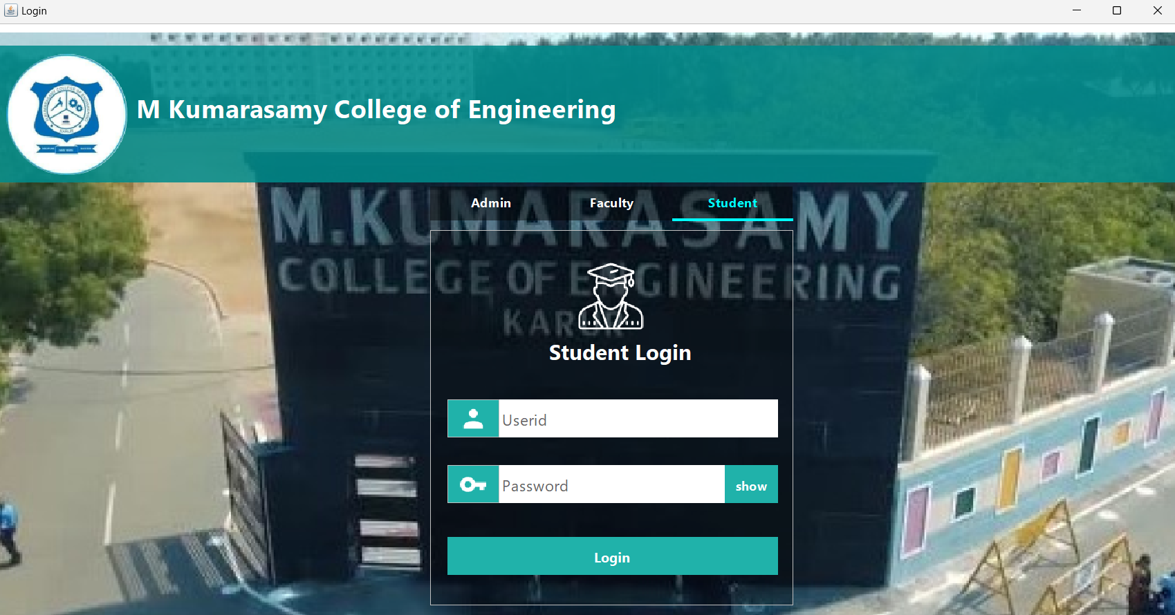
Results and Discussion
Fig. No: 1.Separate Login Portal for Admin, Faculty and Students

Slide 17
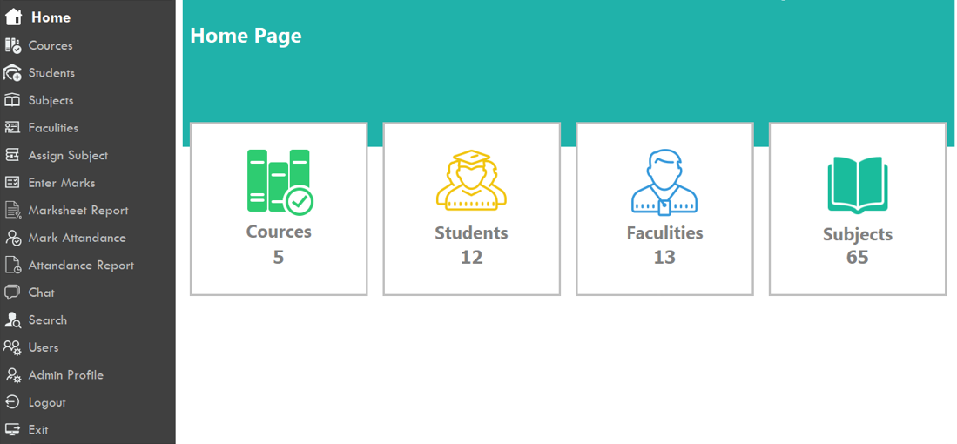
Results and Discussion
Fig. No: 2. Generalized Home Page which has Dashboard View of Courses, Students and Faculties.

Slide 18
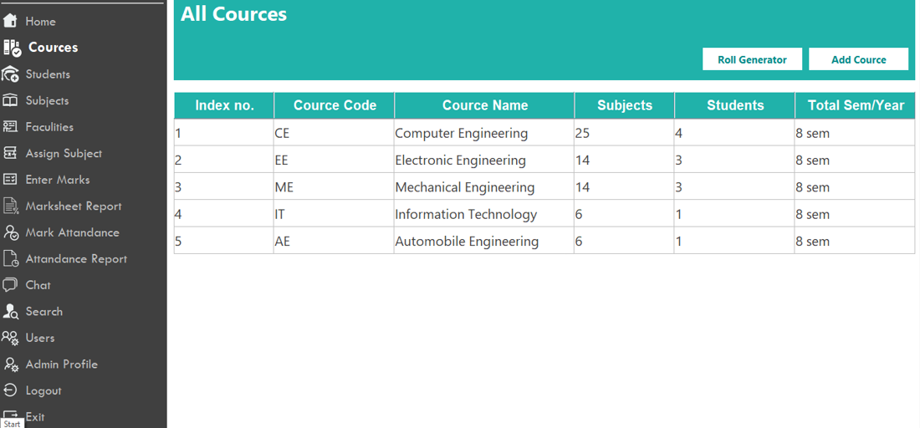
Results and Discussion
Fig. No: 3.Courses Tab which shows the list of Courses (Departments)

Slide 19
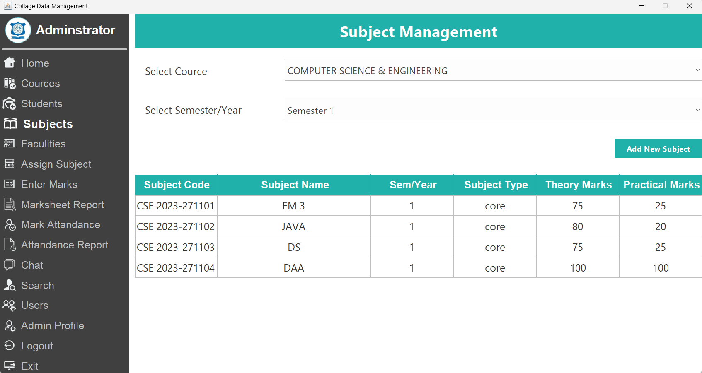
Results and Discussion
Fig. No: 4. Subject Management Page used to Maintain Subjects for Departments.

Slide 20
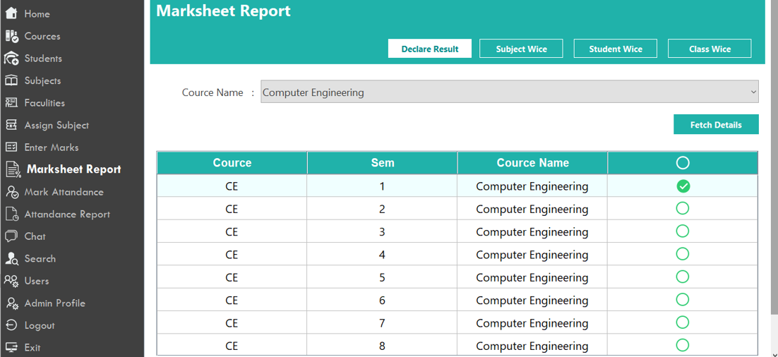
Results and Discussion
Fig. No: 5. Marksheet Page used to Declare Result of Semester Examinations.

Slide 21
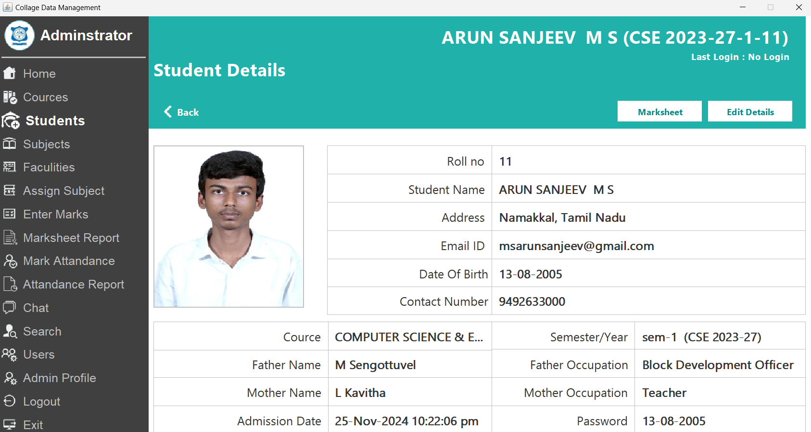
Results and Discussion
Fig. No: 6. Student Details Management which allow to manage the Student Data.

Slide 22
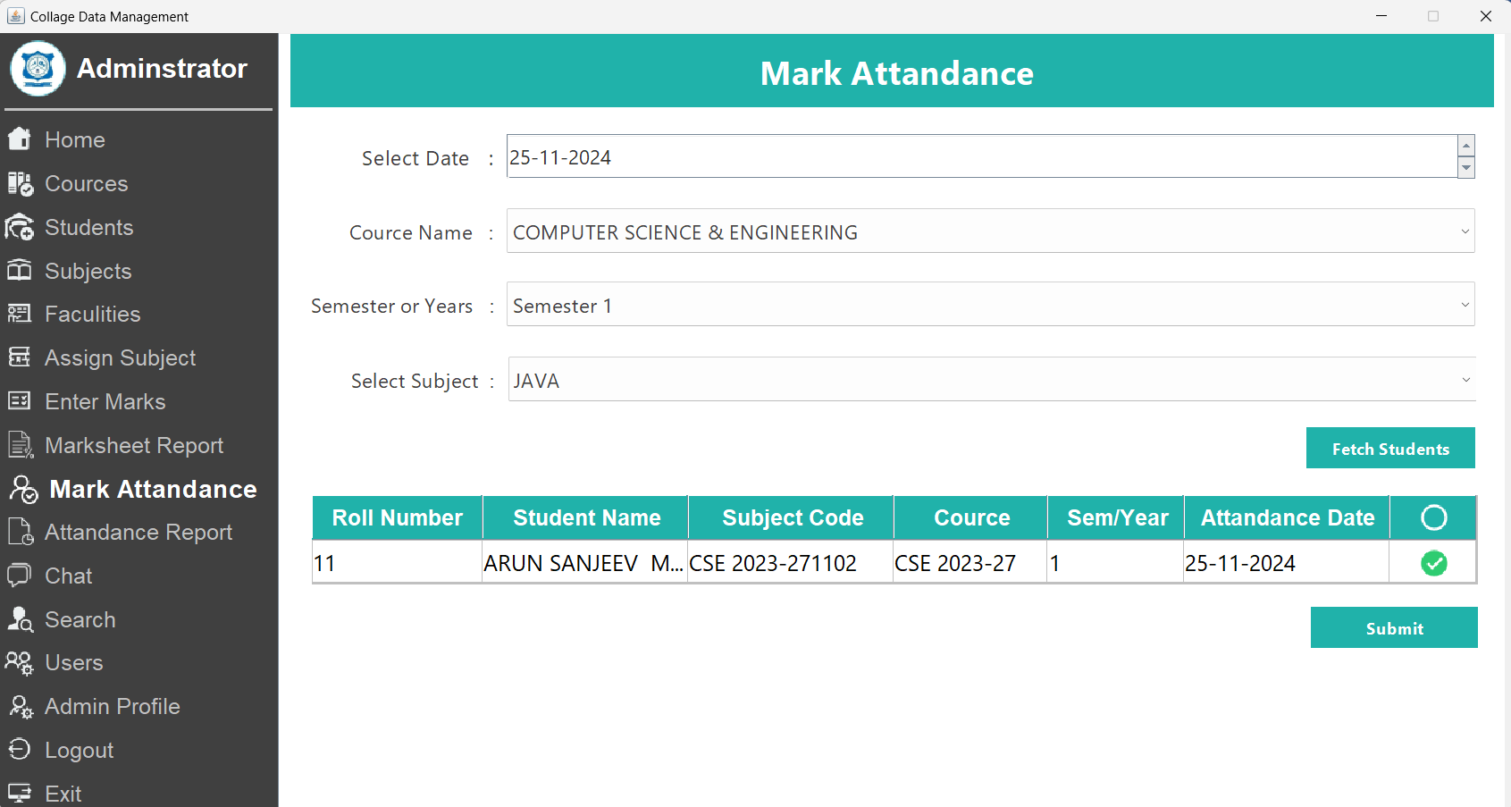
Results and Discussion
Fig. No: 7. Attendance Page to Mark Attendance

Slide 23
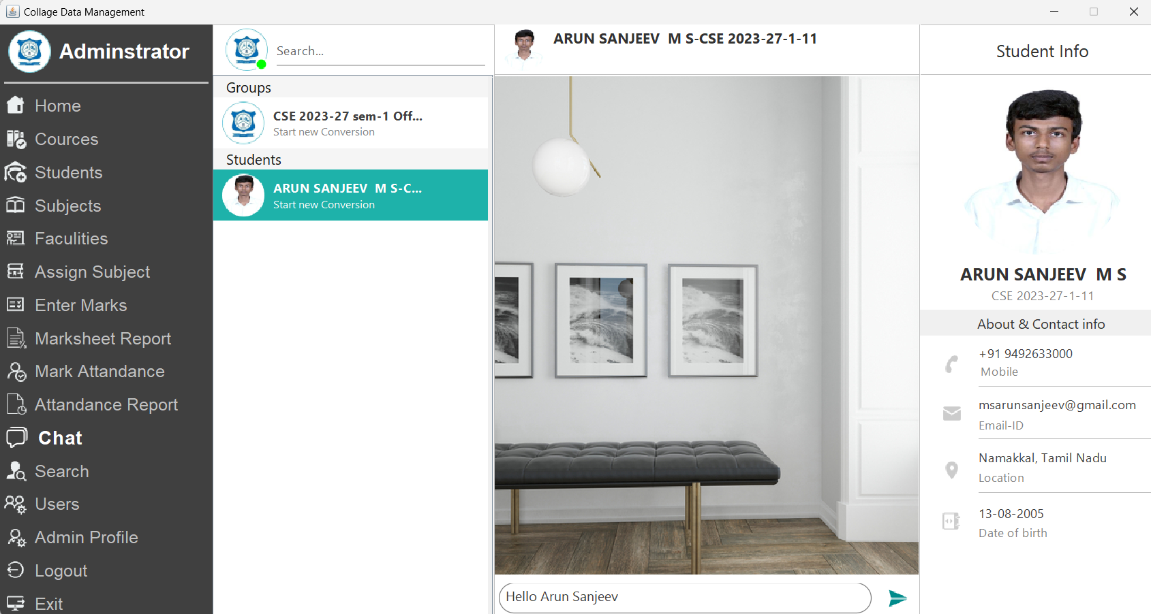
Results and Discussion
Fig. No: 8. Chat Forum for Communication of Exam Notifications and Circulars

Slide 24
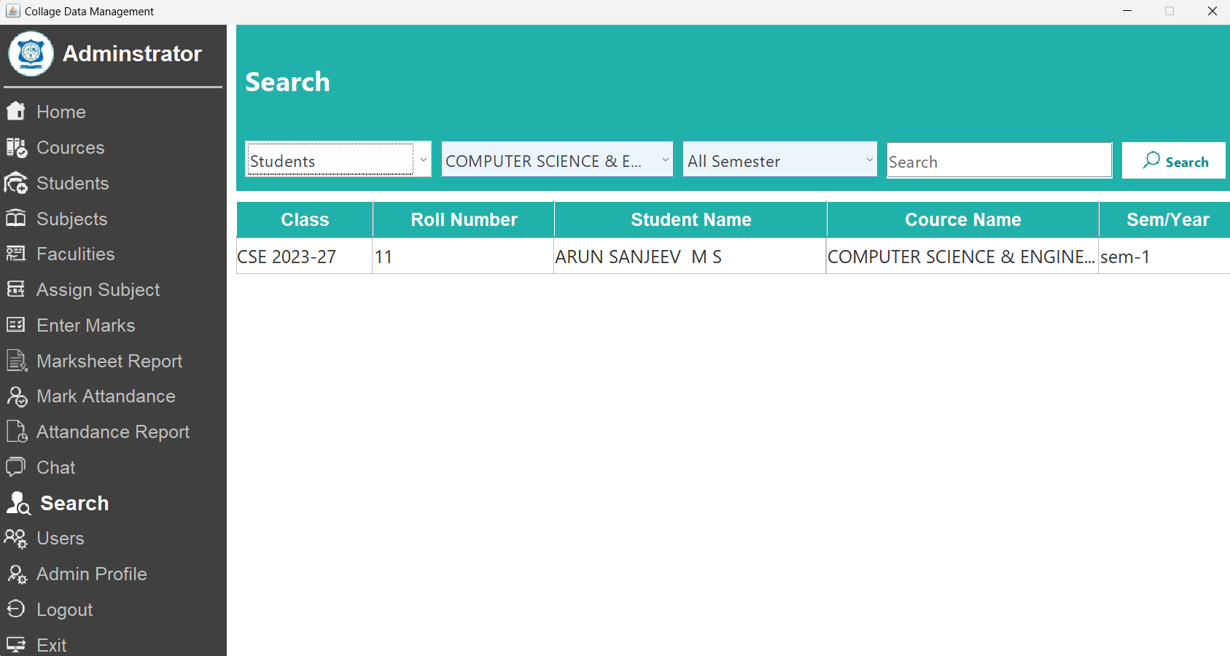
Results and Discussion
Fig. No: 9. Detailed Deep Search to Search Faculties / Students

Slide 25
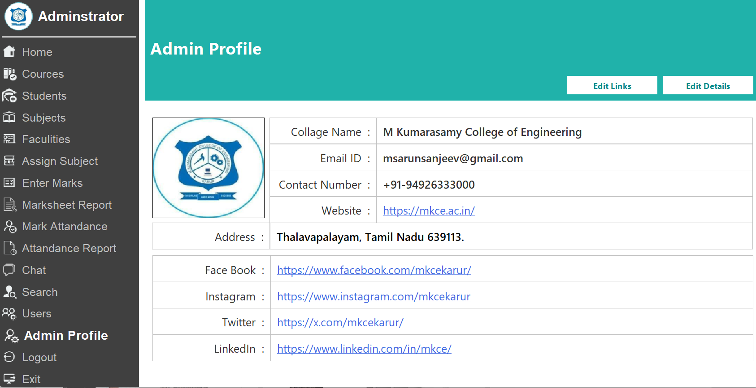
Results and Discussion
Fig. No: 10. Admin Profile Editor to Modify Admin Details.

Slide 26
Conclusion
In conclusion, the College Management System is a comprehensive and efficient application that streamlines various administrative and academic tasks within a college. This project demonstrates the integration of modern technologies like Java for object-oriented programming and MySQL for robust database management. The system effectively addresses the challenges faced in managing student records, faculty details, courses, attendance, and results, ensuring a seamless experience for administrators, faculty members, and students.
The user-friendly graphical interface makes the application accessible to nontechnical users, while the robust backend handles large datasets efficiently. Features like the chat server for real-time communication and notification management further elevate the system's utility, fostering better collaboration within the college community. This project underscores the importance of leveraging technology to address realworld challenges in educational institutions. It also highlights the critical role of teamwork, systematic problem-solving, and continuous testing in software development.

Slide 27
Thank You
Any queries???

